Slide 1
A Journey with Data -Microsoft Office Excel
BNU-HKBU
United International College

Slide 2
Outlines
Excel introduction
Numbers format and calculation
Excel Functions
Charts

Slide 3
Vocabulary
Accomplish: 完成
Argument: 论点, 变量
Ascend: 上升
Colon: 冒号
Comma: 逗号
Computerized: 计算机化的
Descend: 下降
Distinguishing: 有区别的
Enclose: 把…围起来
Entry: 入场, 进入
Formula: 公式, 准则
Identify: 确定, 识别
Parentheses: 圆括号
Resize: 调整大小
Square root: 平方根
Wizard: 向导, (男) 巫师

Slide 4
Excel
Excel is a computerized spreadsheet, which is an important business tool that helps you report and analyze information.
Excel stores spreadsheets in documents called workbooks.
Each workbook is made up of individual worksheets, or sheets.
Because all sorts of calculations can be made in the Excel spreadsheet, it is much more flexible than a paper spreadsheet.

Slide 5
Start a workbook
Start Excel by one of the following
Double-click the Excel icon in the Desktop
Search for Excel in the Search (magnifying glass) icon, then open Excel
Start a workbook,
Choose File > New
Use this workbook as a doodle workbook
Copy this PPT’s examples into your workbook
Experiment with different values and commands
Submit your workbook to iSpace when you finish this PPT.

Slide 6
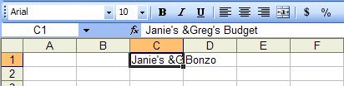
Enter Text
Simply click a cell and type

Slide 7

Enter numbers
Number values are right-aligned.
Label texts are left-aligned.

Slide 8
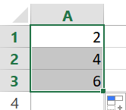
Automatic increase
Drag the little black square at the bottom-right corner of a cell.
It’s called a fill handle.
It fills the cells according to a determined pattern or formula.

Slide 9
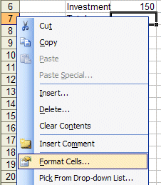



Formatting numbers
Right click on a cell > Format Cells > Number

Slide 10

Resizing rows and columns
Resizing column by doing one of the following:
Dragging the side line at the column header
Right click the column header > Column Width
Resizing row
Similar to above, except change column to row, and Column Width to Row Height.

Slide 11

Adding and renaming worksheets
Adding a worksheet
Right-click on the worksheet tab > Insert > Worksheet
Renaming a worksheet
Right-click on the worksheet tab > Rename

Slide 12
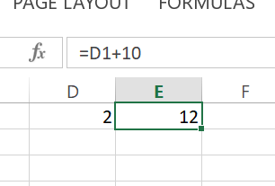
Performing Calculation
Calculations is a distinctive feature of Excel,
Otherwise it is no more than a large table.
Formula calculations
Must begin with equal sign “=” in a cell.
Perform calculations and display the result.
Include cell addresses.
Are visible after the execution in the cell entries of the formula bar.

Slide 13
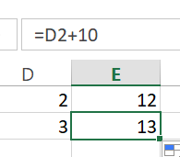
Performing Calculation
Identified cell address by column and row, e.g. D1
Three ways to reference cell address in a formula:
Relative referencing
Specify cells by their column and row labels
The addresses will be changed when copying or using fill handle (little black square)
e.g. E1 "=(D1+10)" becomes
E2 "=(D2+10)"

Slide 14
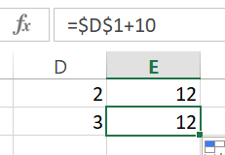
Performing Calculation
Three ways to reference cell address in a formula:
Absolute referencing
Specified by dollar signs "$"
Cell addresses will not change by copying or fill handle
e.g. E1 "=($D$1+10)" becomes
E2 "=($D$1+10)"

Slide 15
Performing Calculation
Three ways to reference cell address in a formula:
Mixed referencing
Only the row or column is fixed.
e.g. "=(A$1+$B2)"
When drag across rows, row 2 will change, but row $1 stays fixed in the formula.
When drag across columns, column A will change, but column $B stays fixed in the formula.

Slide 16
Performing Calculation
Reference operators refer to a cell or group of cells
Range operator “:”
Refers to two cell addresses (of top left and bottom right cells) separated by a colon.
Includes ALL the cells in the reference.
e.g. “A1:C3” includes A1, A2, A3, B1, B2, B3, C1, C2, and C3.

Slide 17
Performing Calculation
Reference operators refer to a cell or group of cells
Union operator “,”
Two or more cells separated by a comma
Refers ONLY to the specific cells (rather than a range)
e.g. “A7,B8,C9” includes only cells A7, B8, and C9

Slide 18
Performing Calculation
Linking worksheets
Use the value from a cell in another worksheet
Format: "sheet_name!cell_address"
e.g.: "=A1+Sheet2!A2"

Slide 19
Functions
Functions
Allow you to quickly perform calculations
Are more efficient than typing formulas
formula: "=D1+D2+D3+D4+D5+D6+D7+D8+D9+D10"
function: "=SUM(D1:D10)"
Formatting functions
Use an equal sign to begin a formula
Specify the function name
Enclose arguments within parentheses
Use a reference operator (a comma “,” or colon “:”) to separate arguments

Slide 20
Functions
Function | Example | Description
SUM | =SUM(A1:A100) | finds the sum of cells A1 through A100
AVERAGE | =AVERAGE(B1:B10) | finds the average of cells B1 through B10
COUNT | =COUNT(B1:B10) | finds the number of items from cells B1 to B10
MAX | =MAX(C1:C100) | returns the highest number from cells C1 through C100
MIN | =MIN(D1:D100) | returns the lowest number from cells D1 through D100
SQRT | =SQRT(D10) | finds the square root of the value in cell D10
TODAY | =TODAY() | returns the current date (leave the parentheses empty)

Slide 21
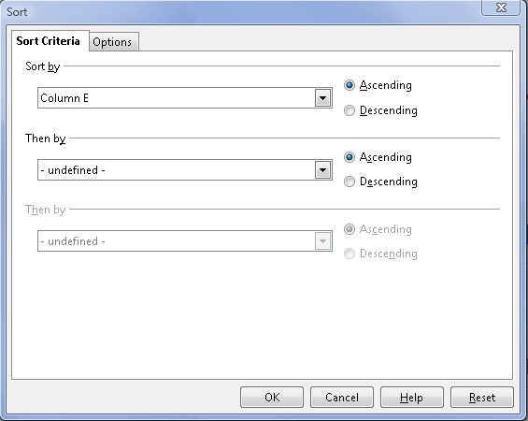
Performing Calculation – Sort
Sort on one column
Sort Ascending button
Sort Descending button
Sort on multiple columns
Highlight all columns
Data > Sort
Select 1st column (key word) in Sort By field
Select 2nd and 3rd column in Then By field.
Choose Header row or No header row box

Slide 22
Creating Charts
Charting – Another important feature
Represent data in a visual format
Often makes it easier to see the relationship
Three popular types:
Line chart – shows a trend during a period of time
Column chart – displays bars of various lengths
Pie chart – shows the relationship of parts to a whole
Chart will automatically update if data changes
Chart Wizard
Easy way to create charts
Highlight all the cells and click Chart Wizard button

Slide 23
Summary
Describe the usage of Excel
Describe the numbers format and calculations
Describe the excel functions
Creating charts

Slide 24
Submit
Recall IntroISpace.pptx on submitting exercises to iSpace.
Put your .xlsx file into the folder “Week1_x123456789”, with x123456789 replaced by your student ID.
Remember to remove any dummy files you previously placed in the folder.
Zip the folder and submit it to iSpace.

Slide 25
References and Further Reading
Open Office Calc:
http://www.openoffice.org/zh-cn/product/calc.html
Zoho Sheet
http://www.zoho.com

